Slide 1

CHAMPIONSHIP HISTORY TRACKER

Slide 2

OVERVIEW
01
Introduction
02
Components of Championship history tracker
03
History of champions in certain sports

Slide 3


01
INTRODUCTION

Slide 4



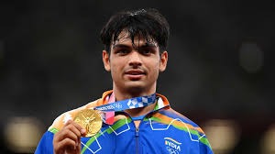
What is Championship History Tracker?
A championship history tracker is a software tool designed to store, manage, and display information about past championships in various sports or competitions.
It allows users to track the winners, runners-up, and other relevant details of championships over time. In this you come across through all championship details of certain sports and games.

Slide 5

COMPONENTS OF CHAMPIONSHIP HISTORY TRACKER
02

Slide 6
Data Model
Define the structure of championship data, including fields like name, year, winner, runner-up, and any additional details.
Database
Setup
Set up a database management system (e.g., SQLite, MySQL) to store championship records. Create tables to store championship data.
User Authentication
and Authorization
Implement user authentication and authorization mechanisms to control access to certain features or data. This ensures that only authorized users can perform CRUD operations or access sensitive information.
Implement search and filter functionality to allow users to search for specific championships or filter data based on criteria such as year, sport, or country.
Search and Filter Functionality
Backend
Development
Implementing CRUD operations.
Create , Read , Update , Delete.

Slide 7


03
History of champions in certain sports

Slide 8
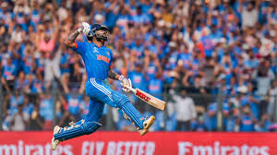

Sports we have chosen for this project
1.Cricket
2.Basket ball

Slide 9


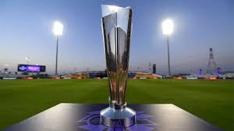
YEAR | WINNERS | RUNNERS
2007 | India | Pakistan
2009 | Pakistan | Sri Lanka
2010 | England | Australia
2012 | West Indies | Sri Lanka
2014 | Sri Lanka | India
2016 | West Indies | England
2021 | Australia | New Zealand
2022 | England | Pakistan
CRICKET
T20 Match

Slide 10

YEAR | WINNERS | RUNNERS
2016 | Sunrises Hyderabad | Royal Challengers Bangaluru
2017 | Mumbai Indians | Rising Pune Super Gaint
2018 | Chennai Super Kings | Sunrises Hyderabad
2019 | Mumbai Indians | Chennai Super Kings
2020 | Mumbai Indians | Delhi Capitals
2021 | Chennai Super Kings | Kolkata Knight Riders
2022 | Gujarat Titans | Rajasthan Royals
2023 | Chennai Super Kings | Gujarat Titans
CRICKET
IPL

Slide 11

Test Cricket
CRICKET
YEAR | WINNERS | RUNNERS
2019-2021 | New Zealand | India
2021-2023 | Australia | India

Slide 12

YEAR | WINNERS | RUNNERS
2007 | Australia | Sri Lanka
2011 | India | Sri Lanka
2015 | Australia | New Zealand
2019 | England | New Zealand
2023 | Australia | India
CRICKET
One-day Internationals

Slide 13

YEAR | WINNER | RUNNER
2002 | India | Bangladesh
2013 | Bangladesh | India
2014 | India | Bangladesh
2015 | India | Sri Lanka
2016 | India | Maldives
2017 | India | Bangladesh
2018 | Sri Lanka | Bangladesh
2021 | India | Sri Lanka
BASKET
BALL
SABA CHAMPIONSHIPS

Slide 14

YEAR | WINNERS | RUNNERS
2016 | Golden State Warriors | Cleveland Cavaliers
2017 | Golden State Warriors | Cleveland Cavaliers
2018 | Golden State Warriors | Cleveland Cavaliers
2019 | Golden State Warriors | Toronto Raptors
2020 | Los Angeles Lakers | Miami Heat
2021 | Phoenix Suns | Milwaukee Bucks
2022 | Golden State Warriors | Boston Celtics
2023 | Minnesota Timberwolves | New York Knicks
BASKET
BALL
NBA FINALS

